Slide 1









ENPI – Climate South Project:
Support Climate Change Mitigation and Adaptation
Mr. Yadh LABBENE, Adaptation Expert
Lebanese Activity: Startup meeting, 5th-6th December 2013

Slide 2
Objective
Support the transition of ENP South countries towards low carbon development and climate resilience
by enhancing regional cooperation, information sharing and capacity development

Slide 3
Purpose & Results

Slide 4
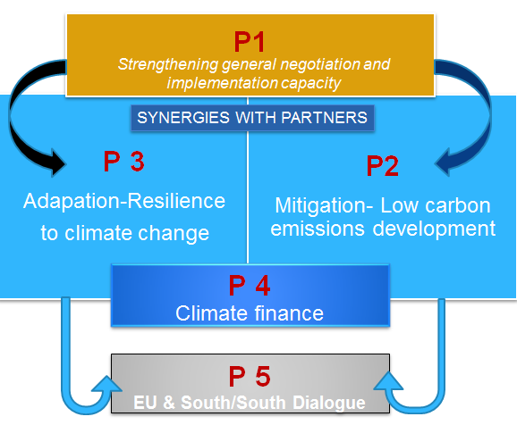
The synergy within the ENPI project

Slide 5
Core ideas to build the Resilience / adaptation component to CC
Pilar
Data
Vulnerability
Adaptation
Data sharing
Regional
Vulnerbility assesment tools
Resilience/Adaptation to CC approches and tools
National/ Local
Adaptation to CC activities / measures

Slide 6
Time Table of Activities
Starting Phase: 01-02-2013
Inception Phase ( 6 months)
Implementation Phase (39 Months)
Closure Phase (3 Months)

Slide 7
Thank you!

